Slide 1
A Look at Sierra Leone to Inspire Global Thinking
Joanie Seacrist
Marla Seacrist

Slide 2
Today’s Objective
To inspire you to inspire your students, to make a difference in this world
To explore options of engaging your students with world communities

Slide 3
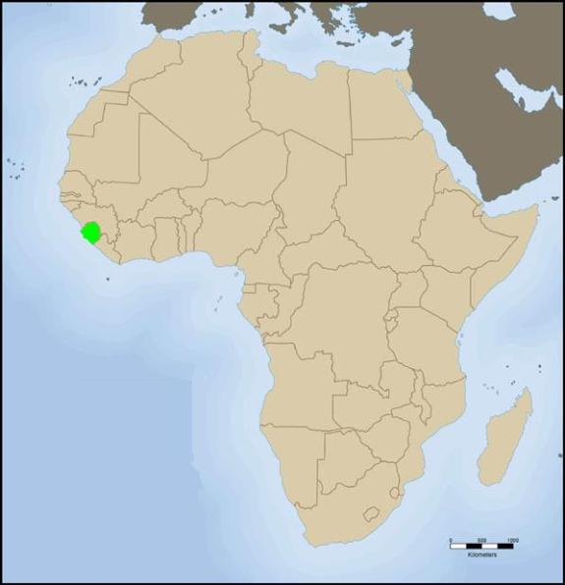
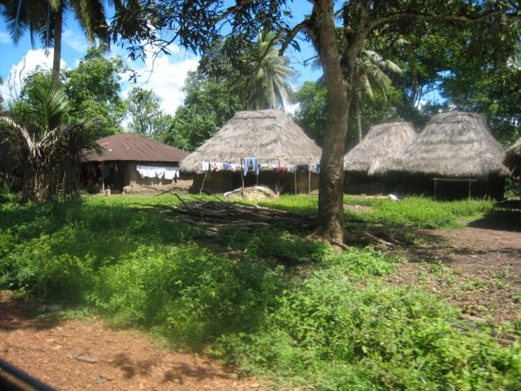
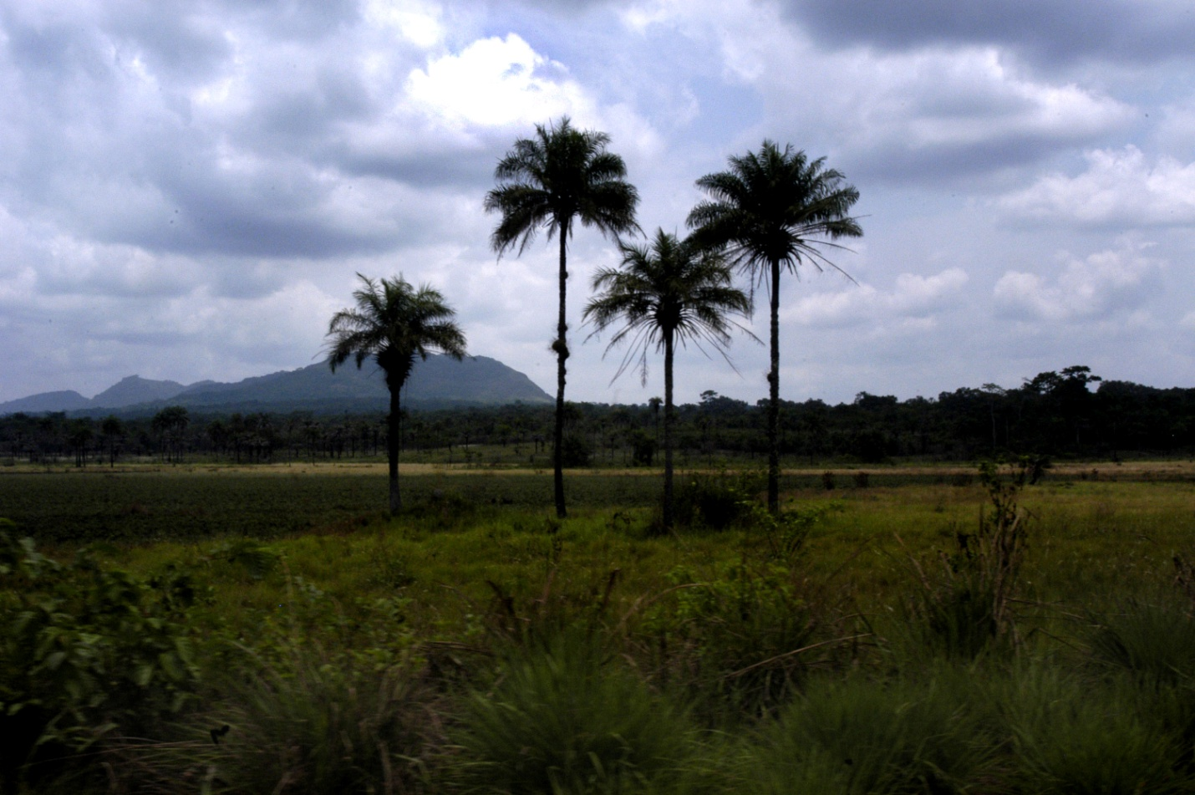
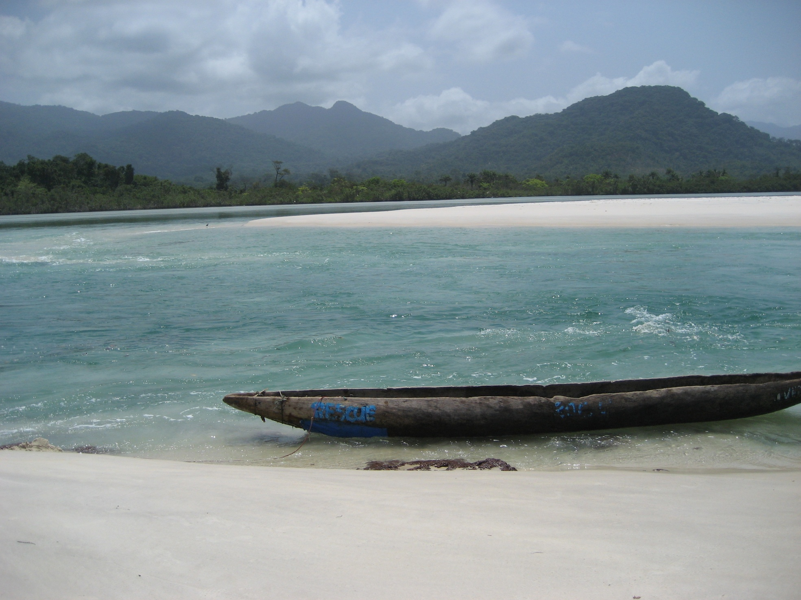

Slide 4
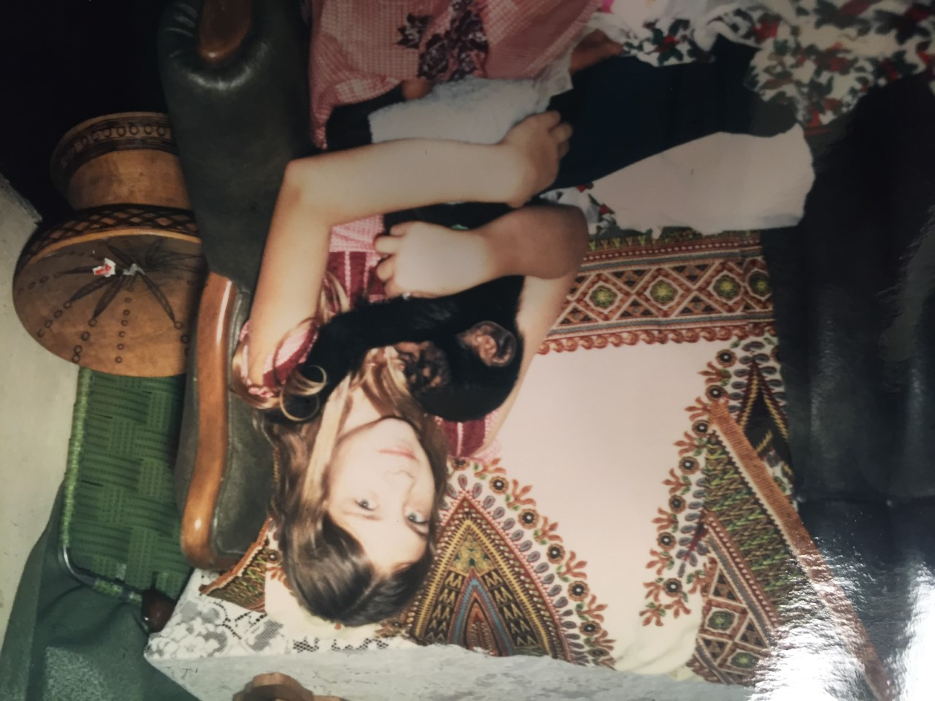
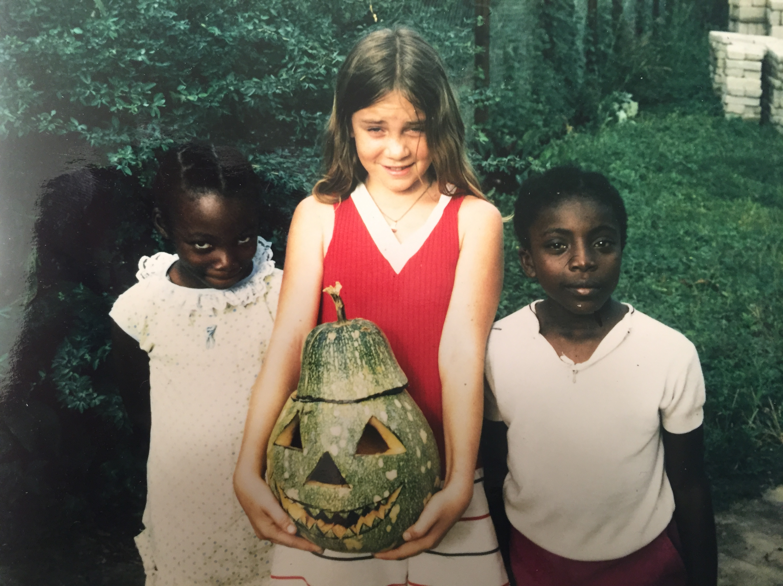
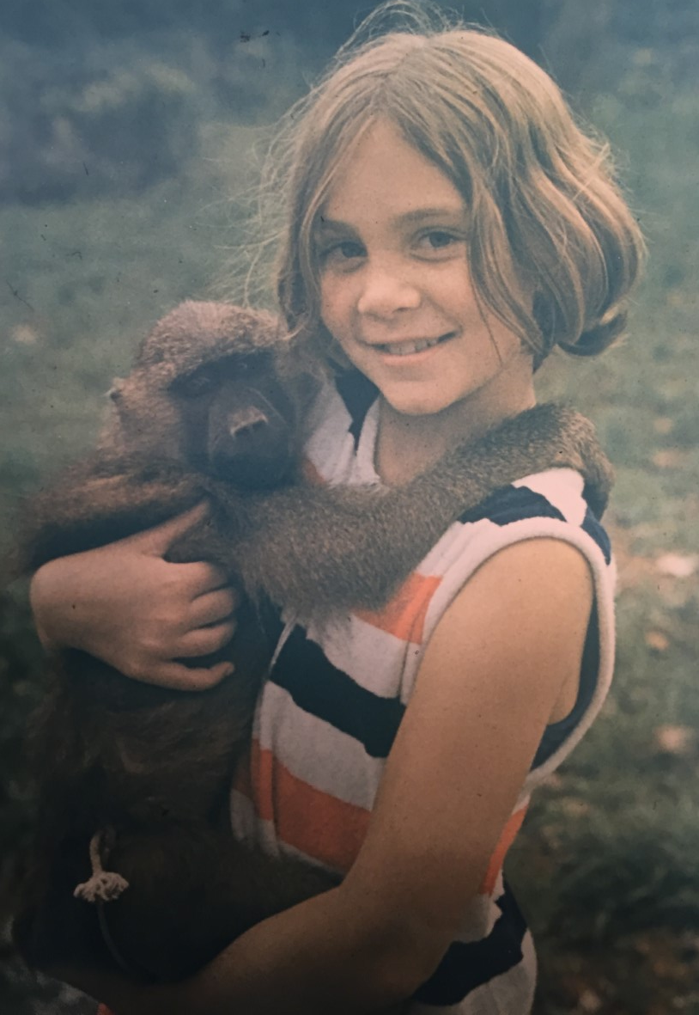

Slide 5
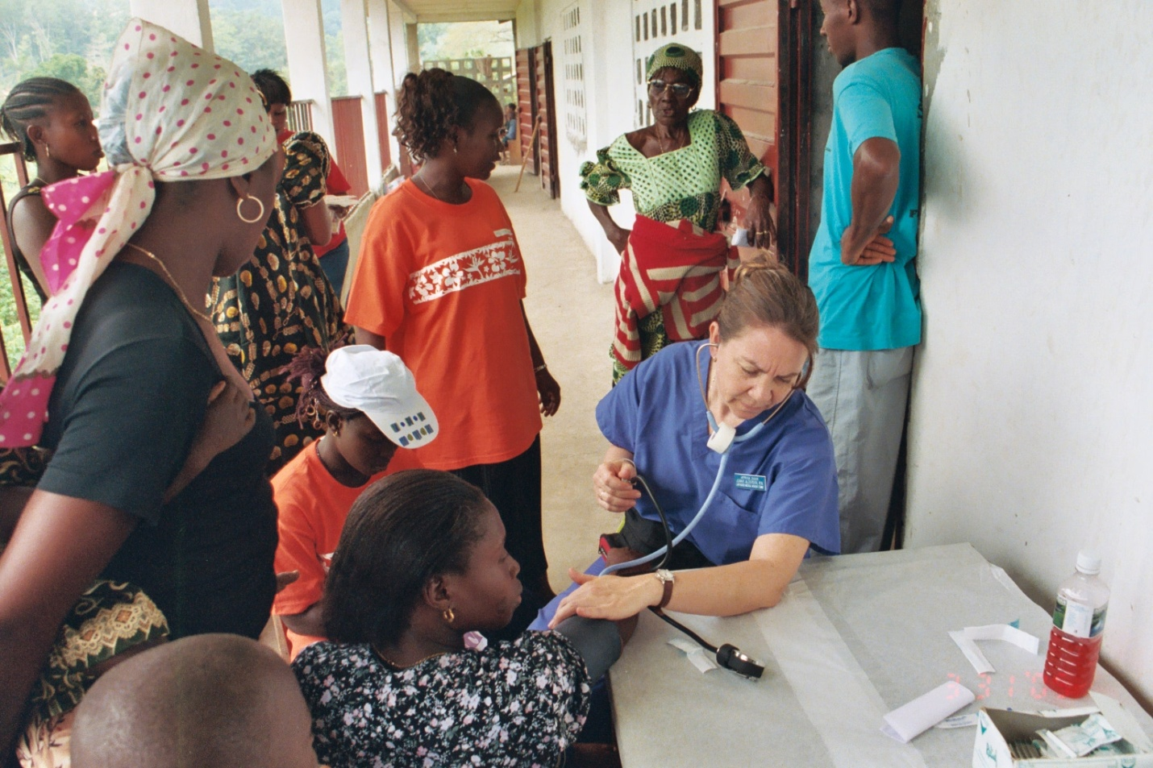
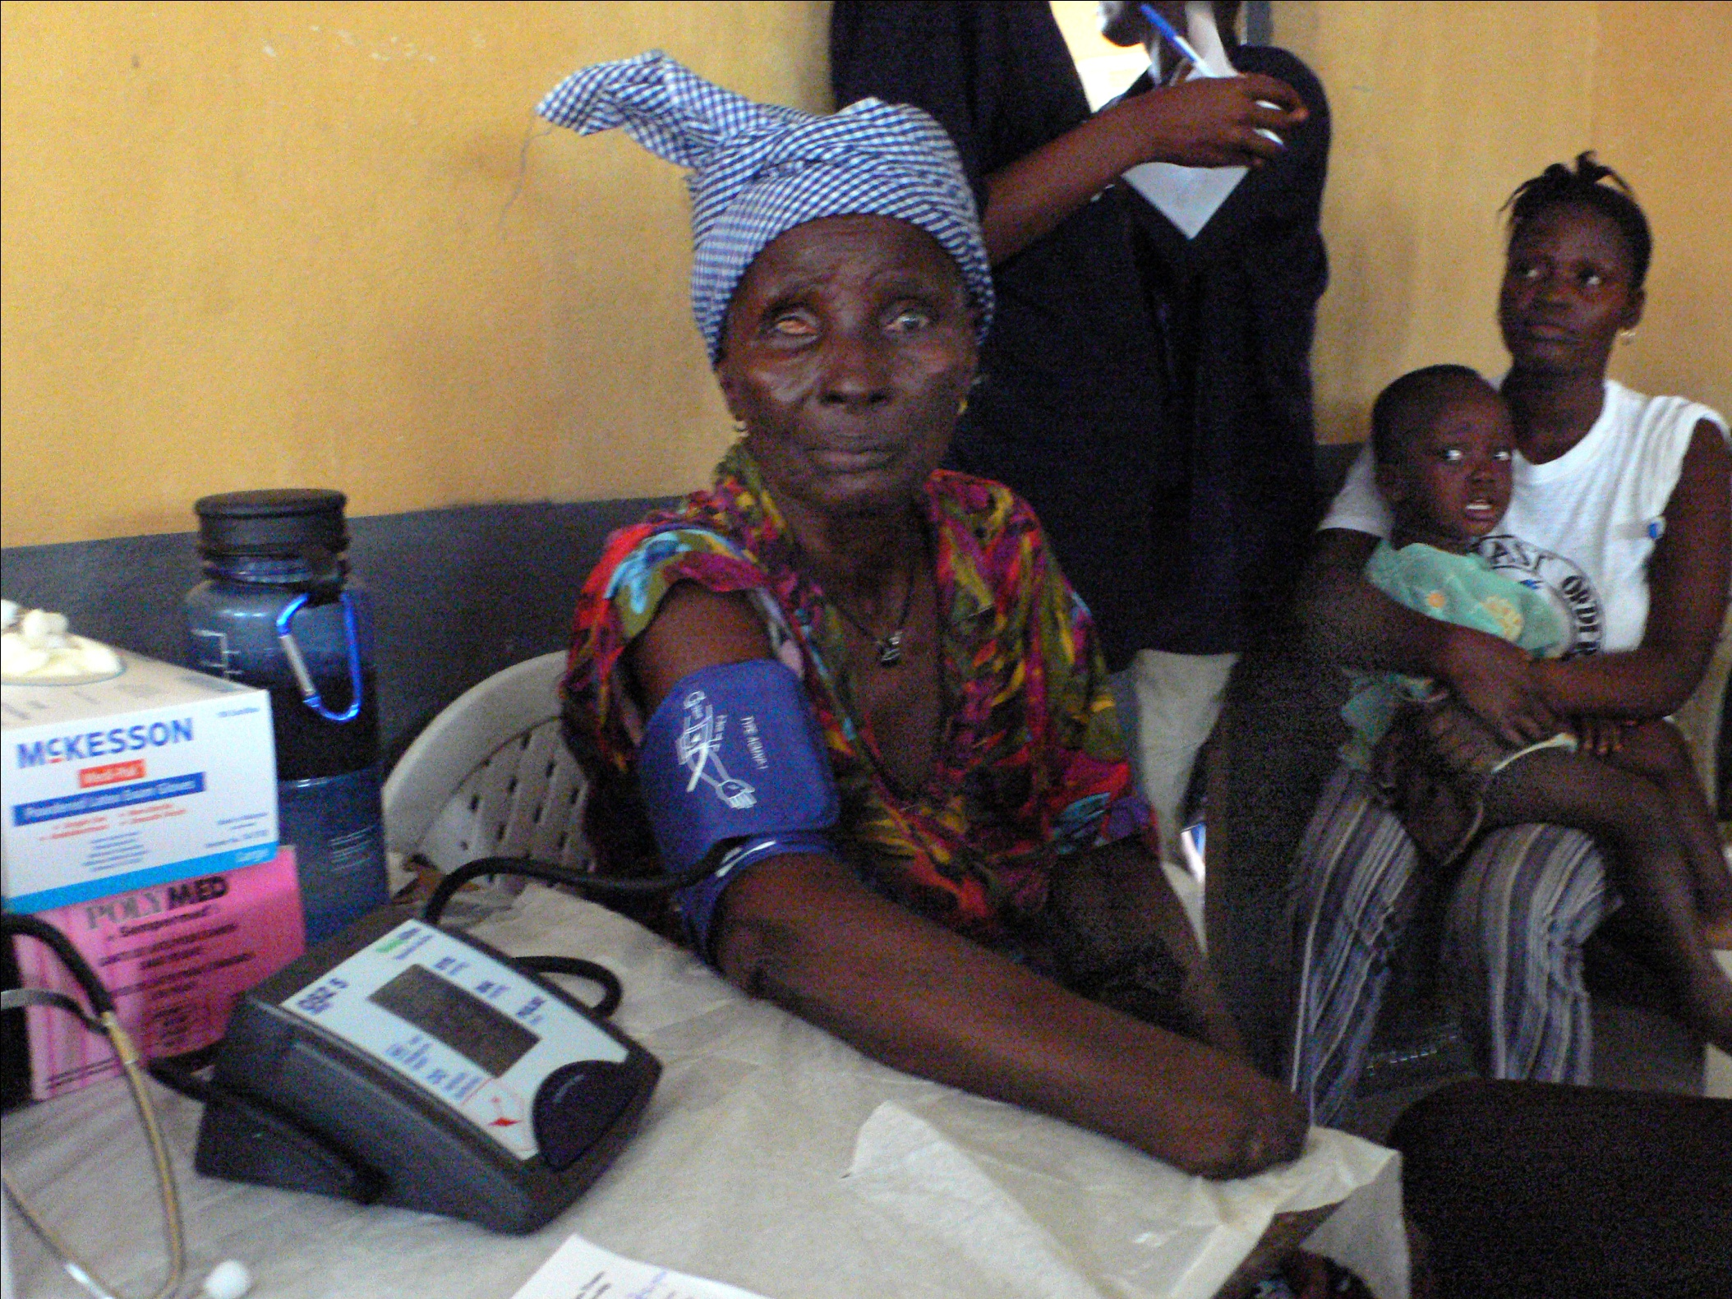

Slide 6
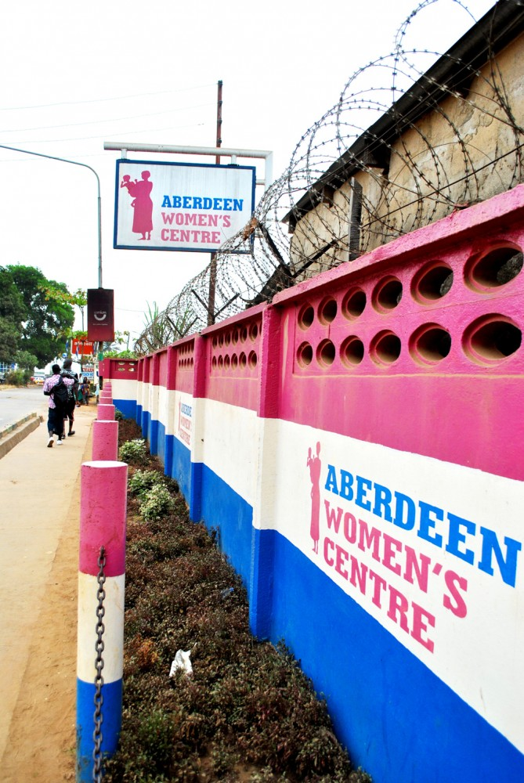
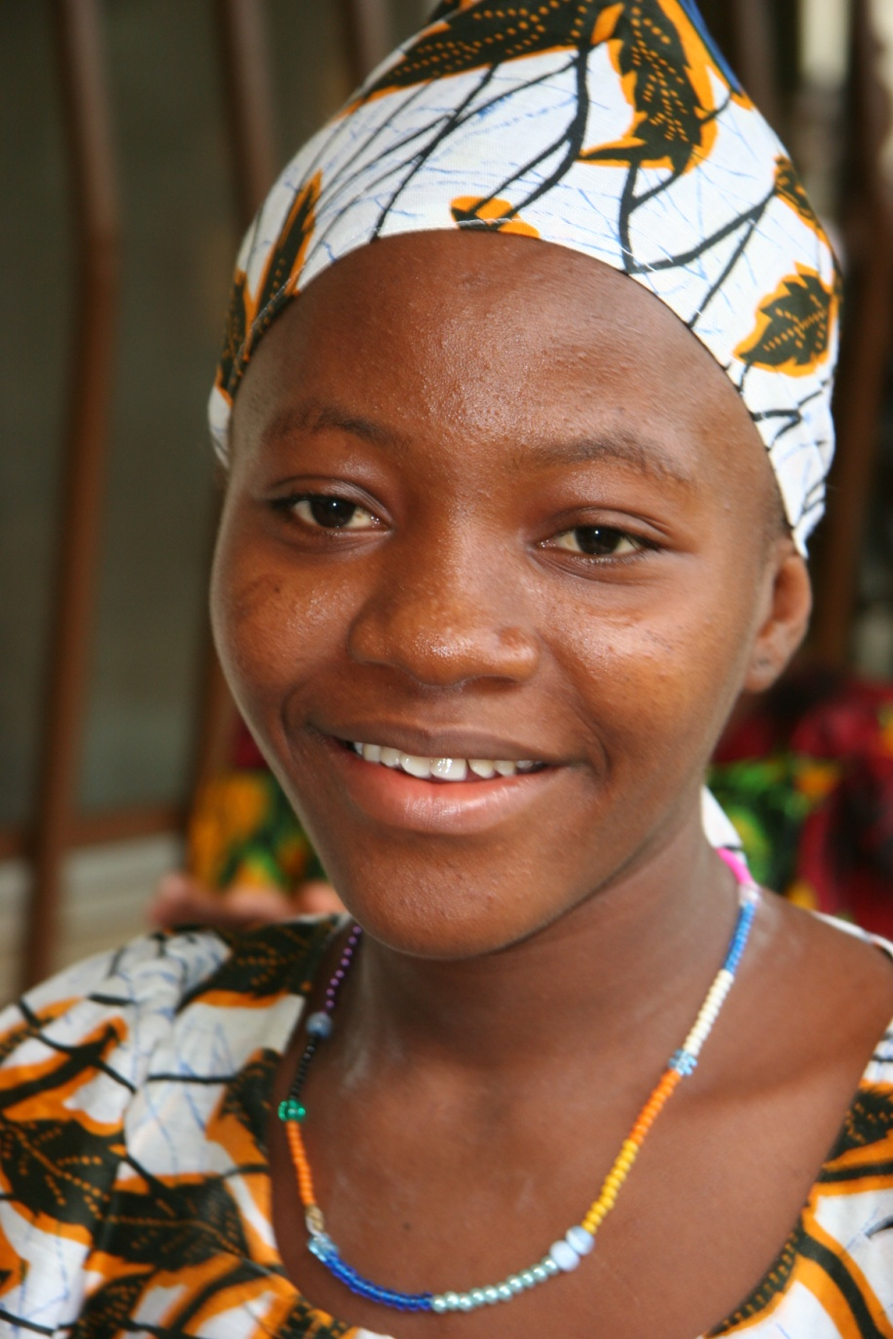
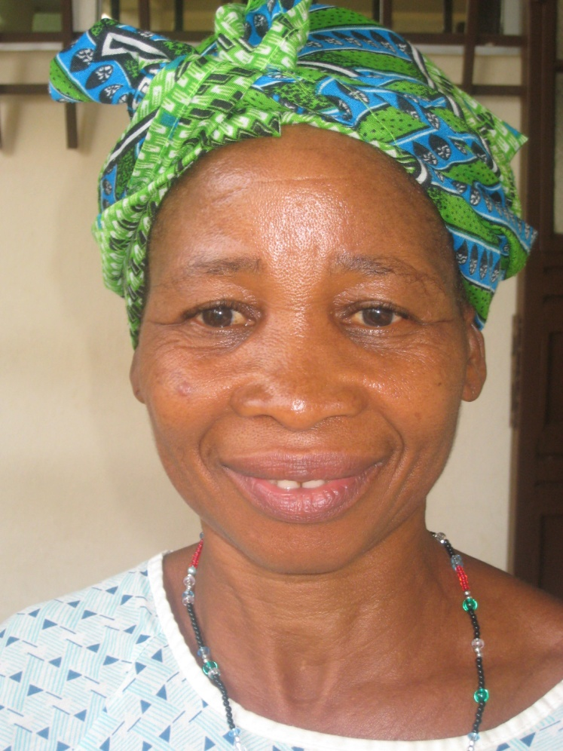
Ward Supervisor

Slide 7
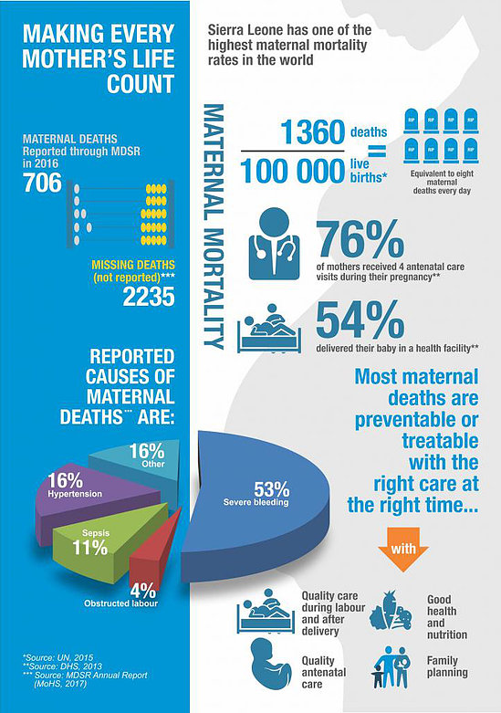

Slide 8
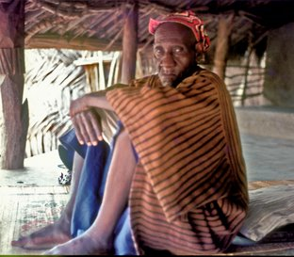
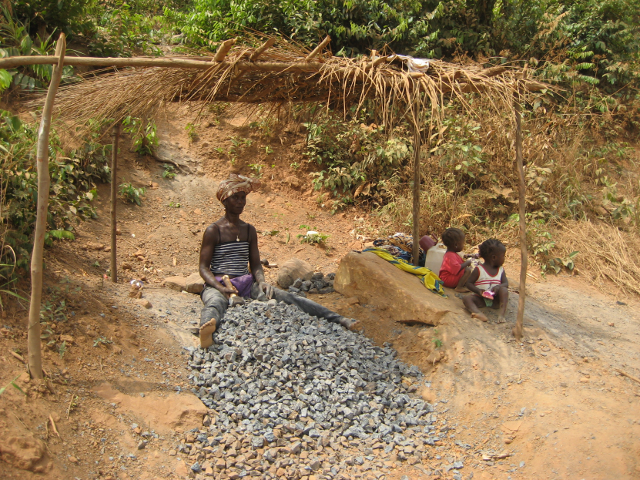
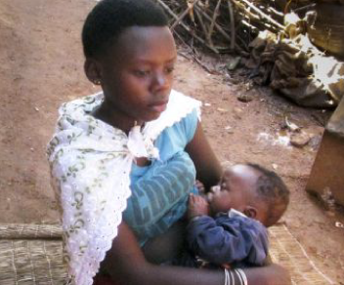
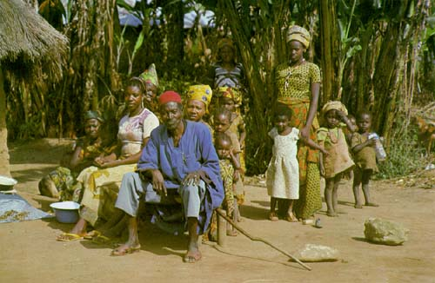
Gender Issues

Slide 9
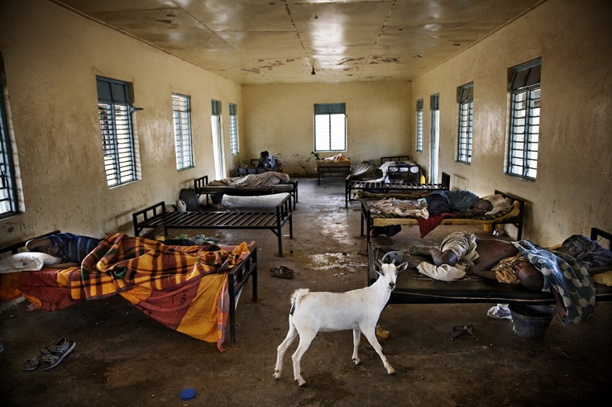
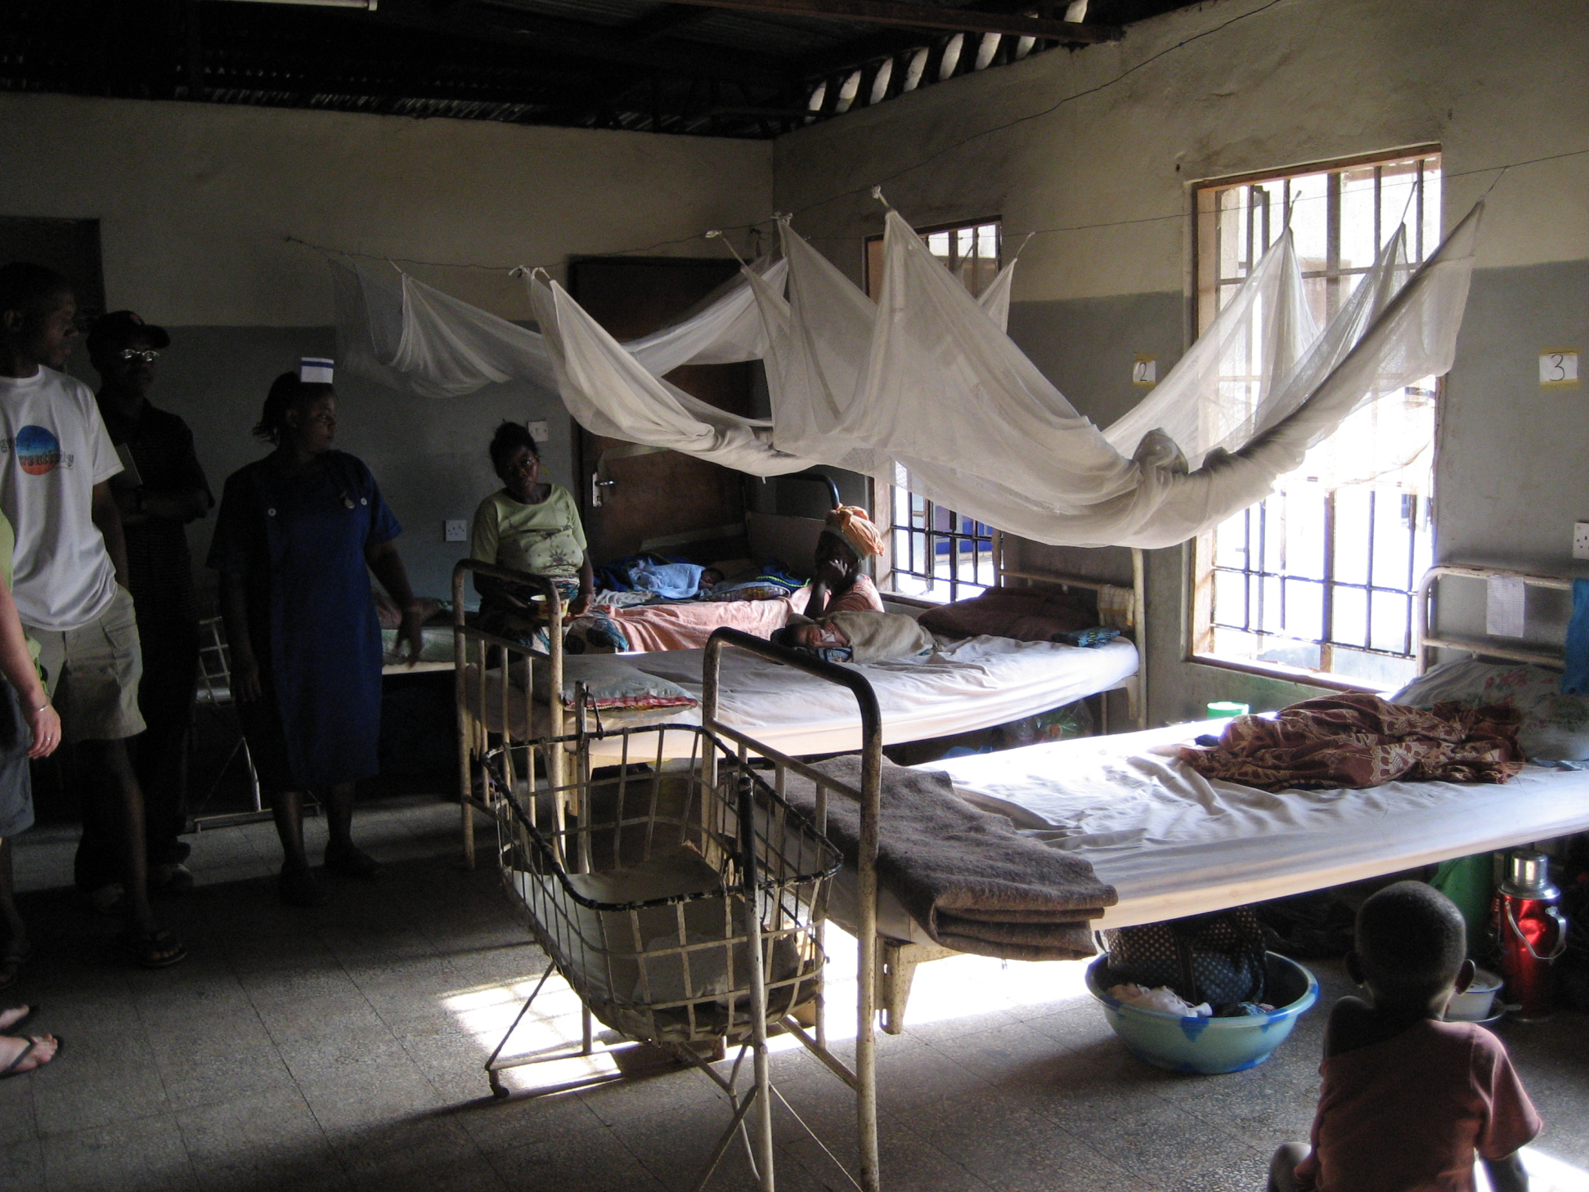
Healthcare Issues

Slide 10
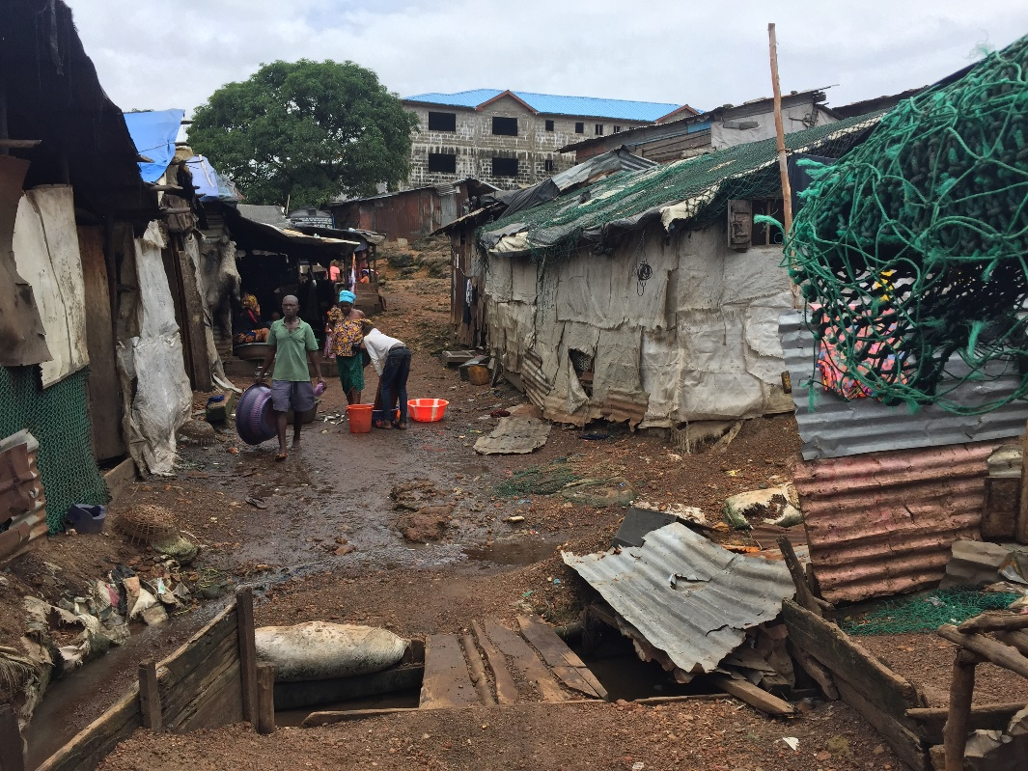
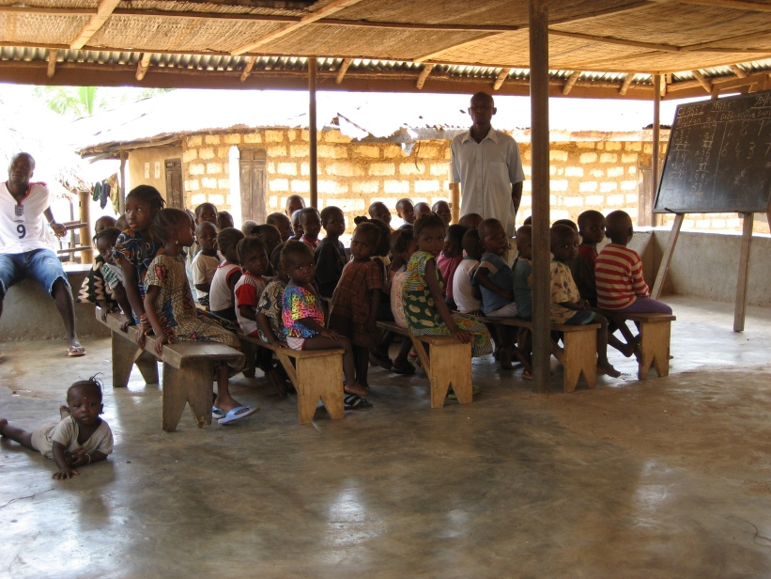
Other Issues That Contribute to Maternal Mortality
Poor roads
Unclean water
Transportation
Legislation (protection acts)
Corrupt government
Superstition (tribal beliefs)
Cheifdom structure
Inadequate education system
Severe poverty

Slide 11
Hawa’s Hope
Our mission is to provide direct support to professional birth attendants through educational events, use of simulation, and one on one mentoring at the bedside, in an effort to reduce the number of women who die in childbirth in Sierra Leone and beyond.

Slide 12
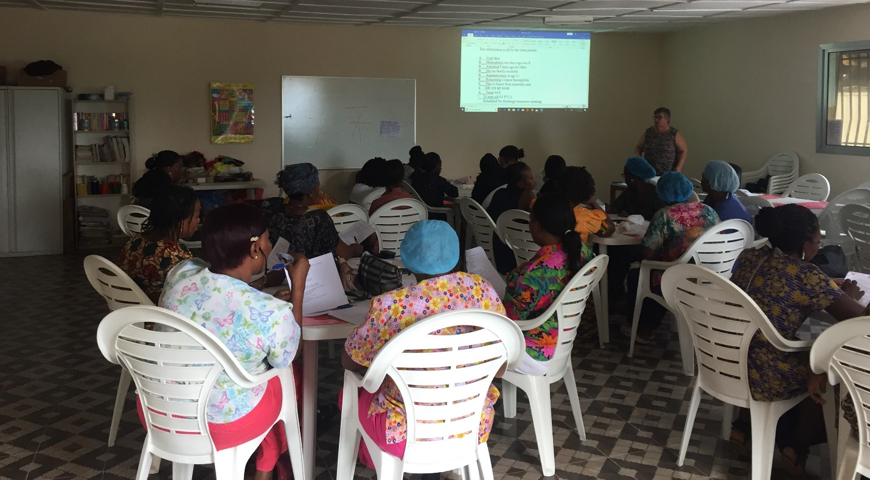
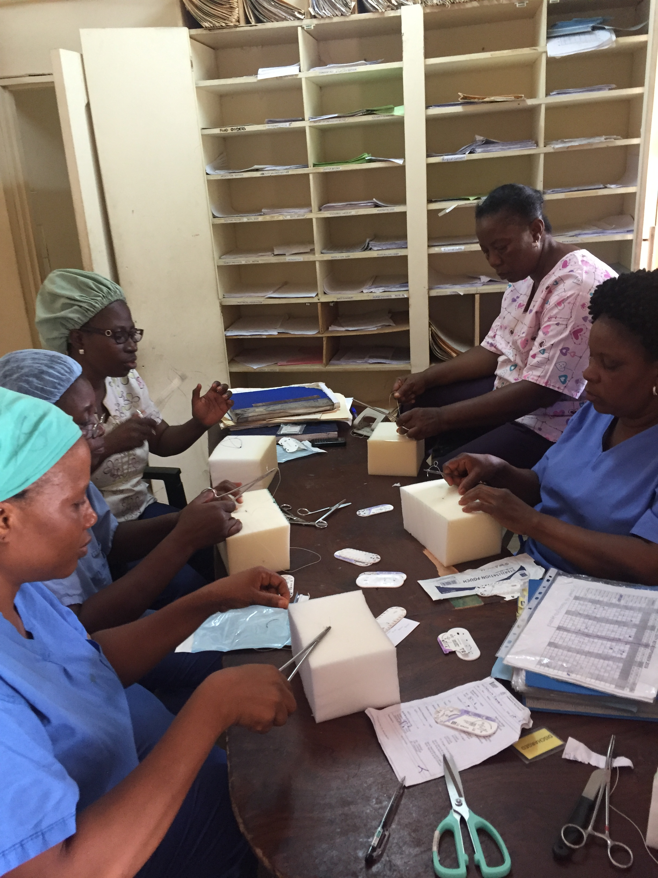
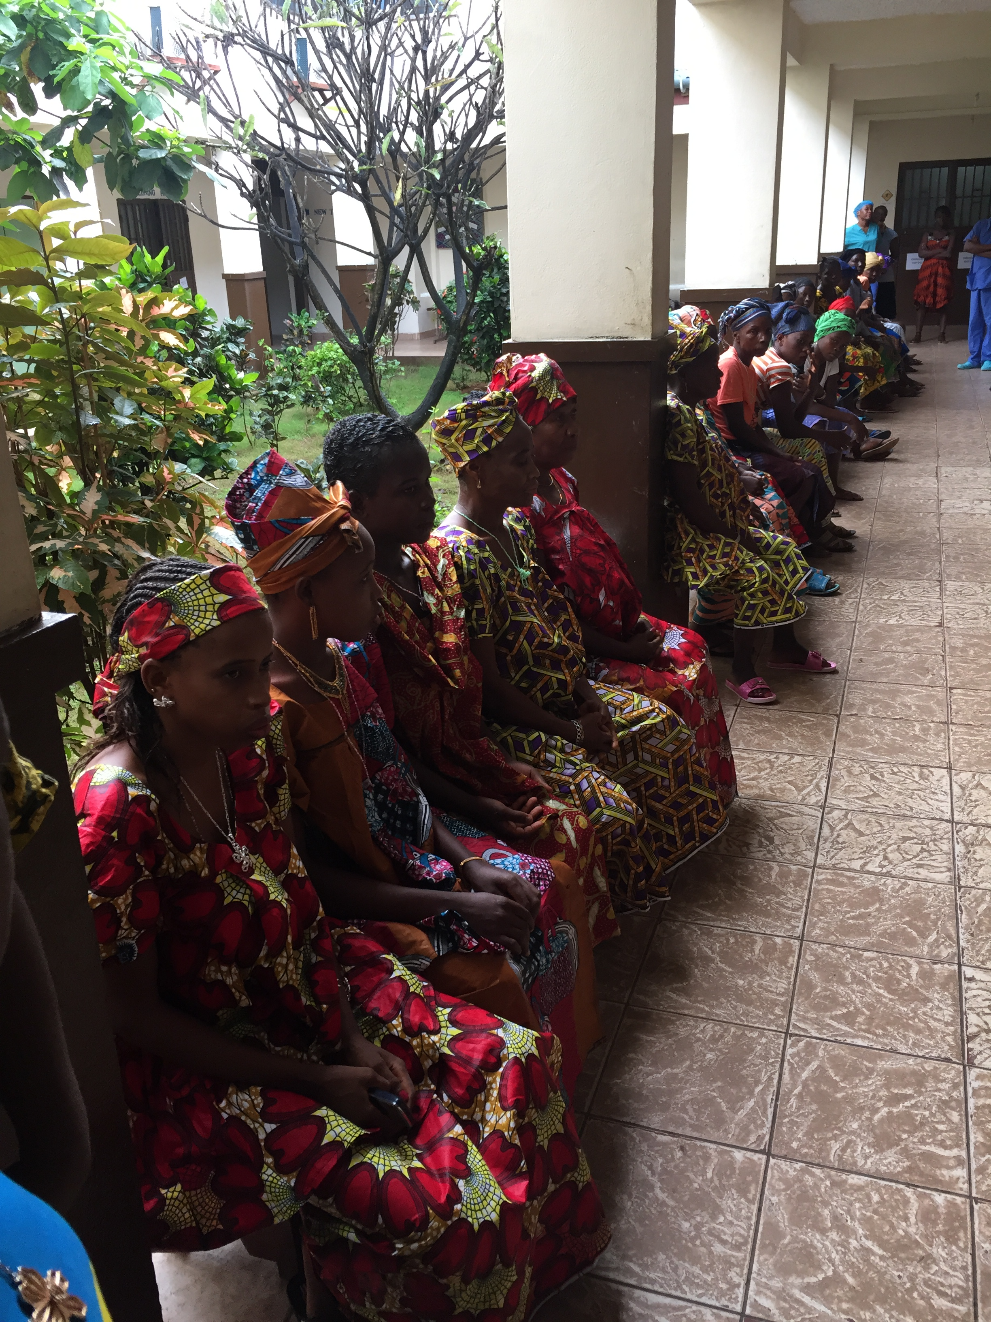

Slide 13
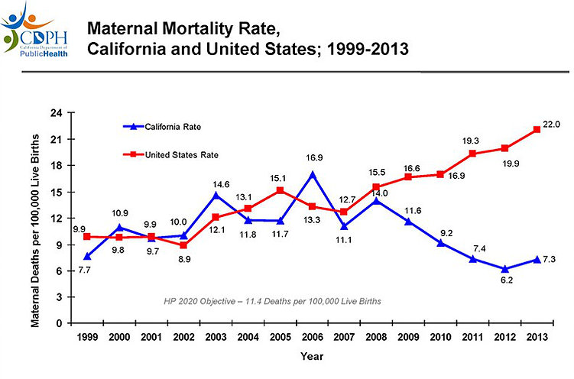
Lessons Learned
Readiness
Recognition
Response
Reporting

Slide 14
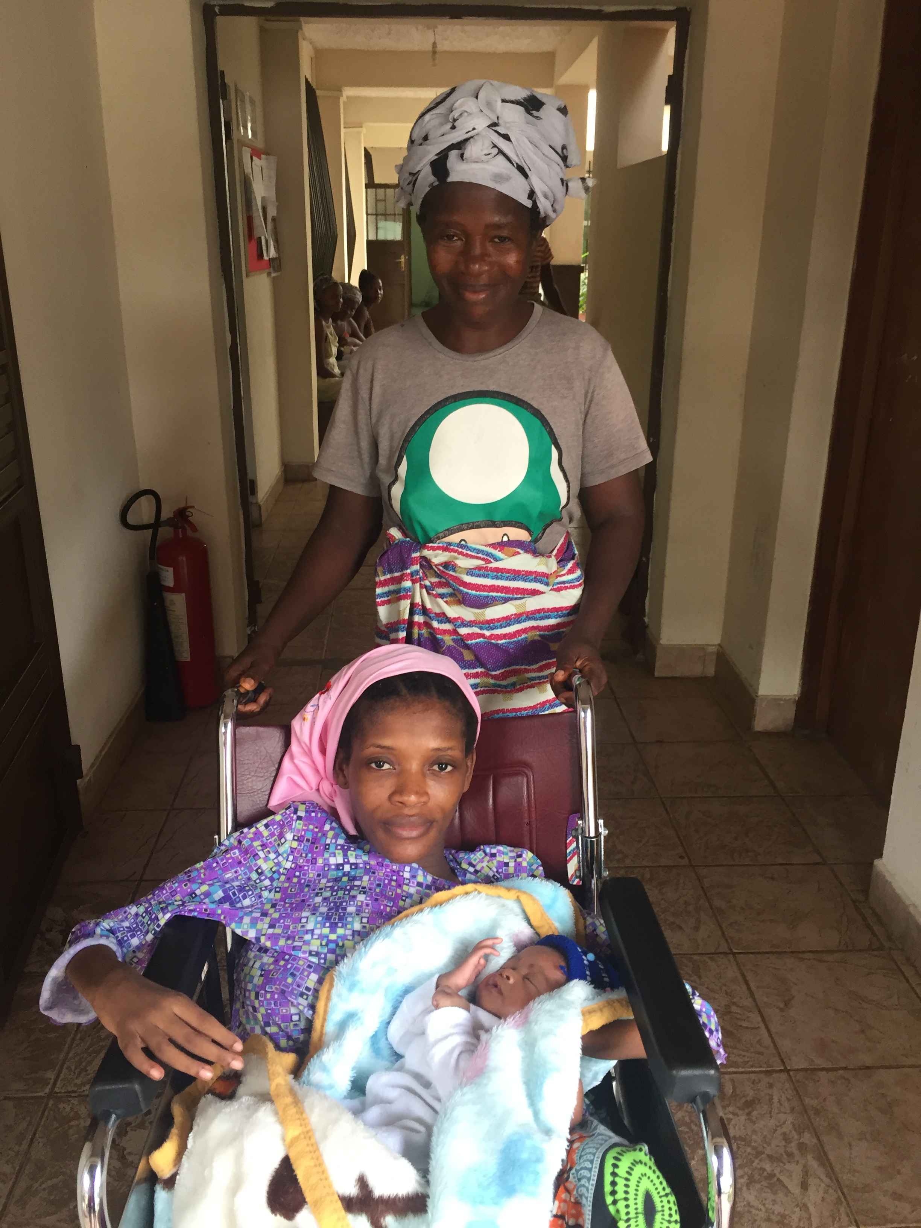
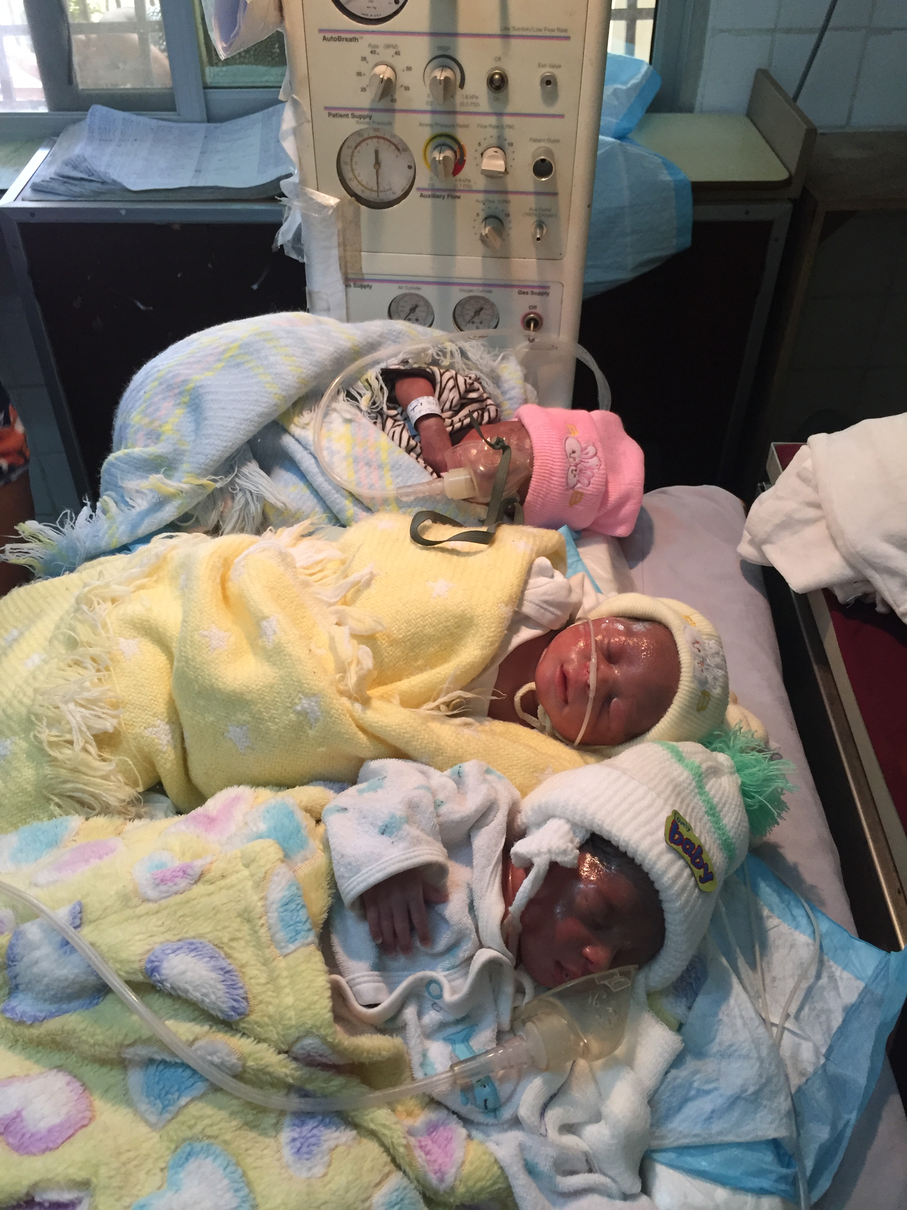

Slide 15
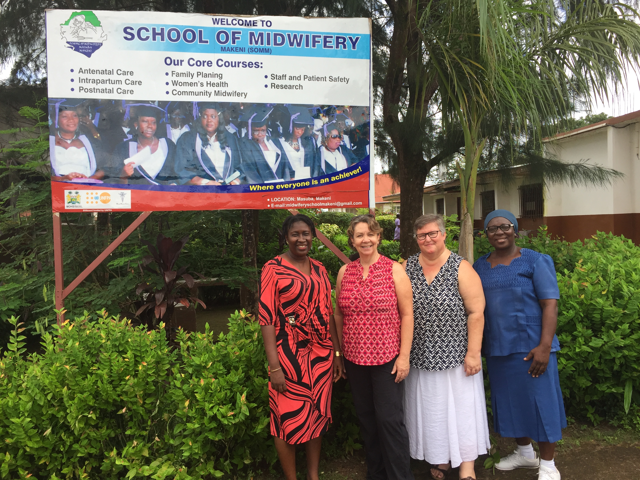
Building Relationships with Midwifery and Nursing Education

Slide 16
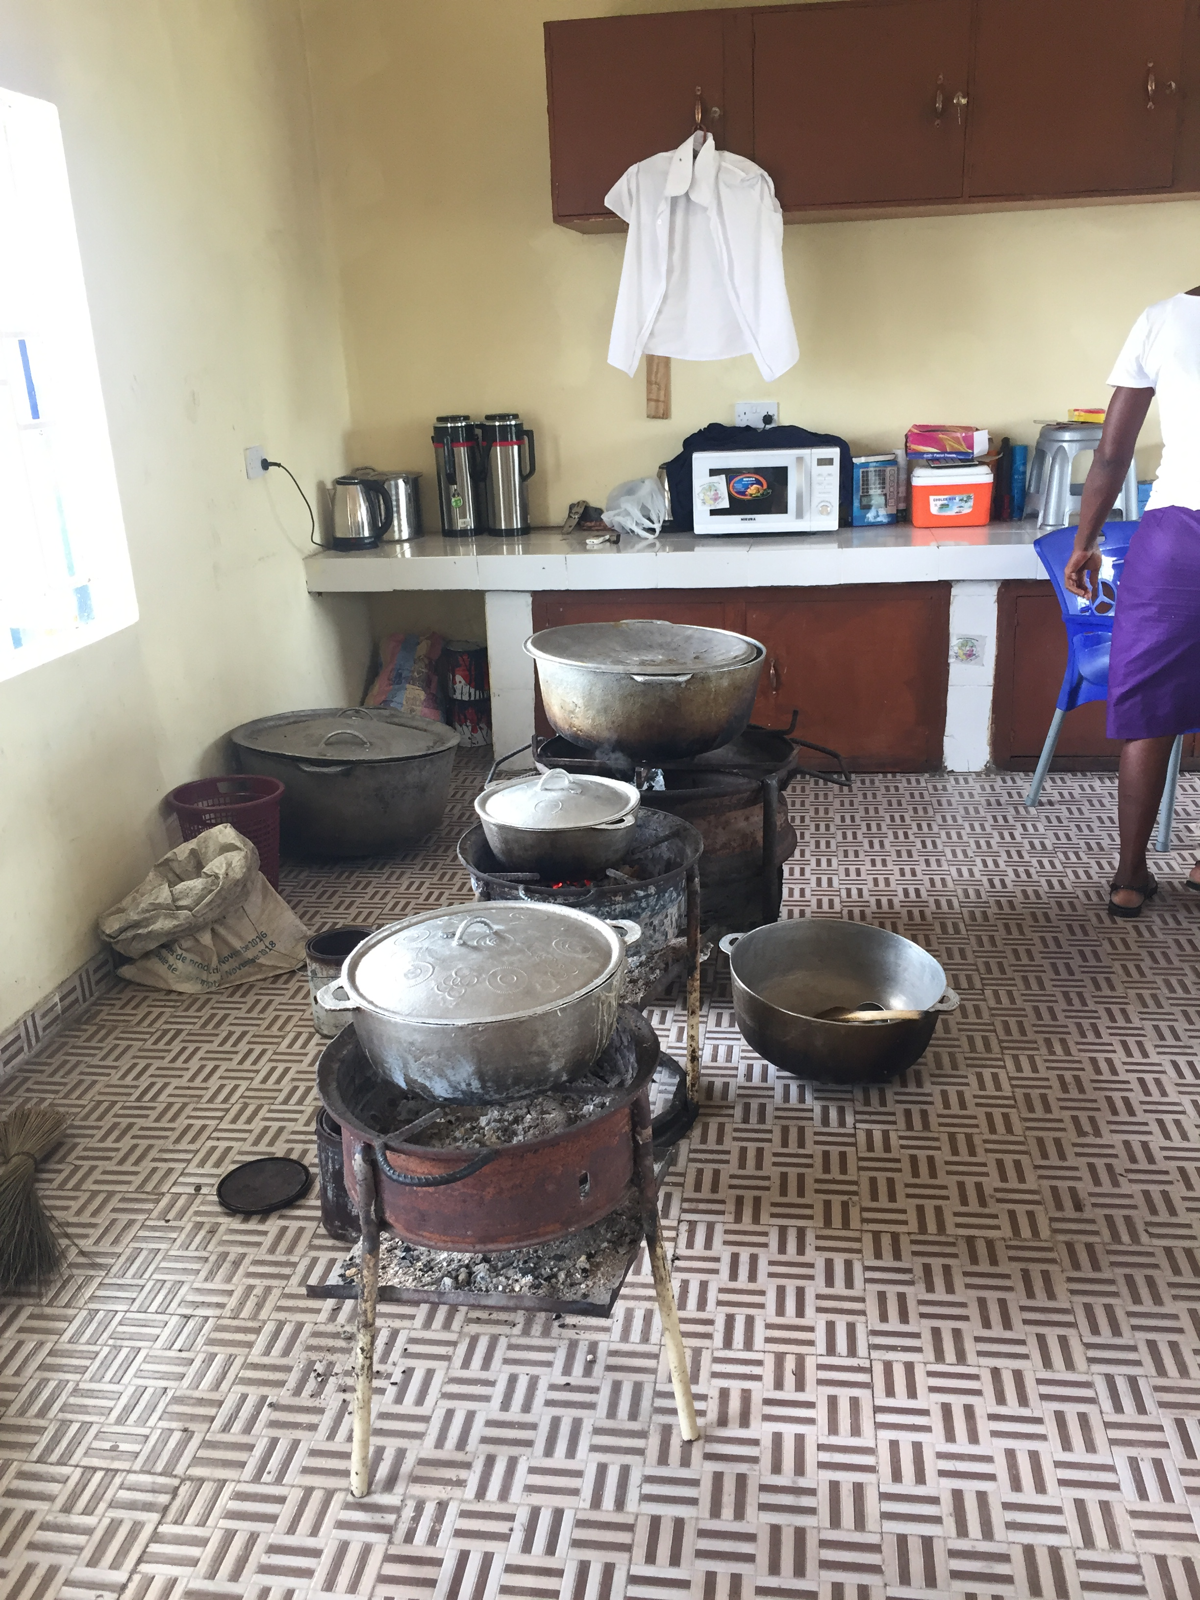
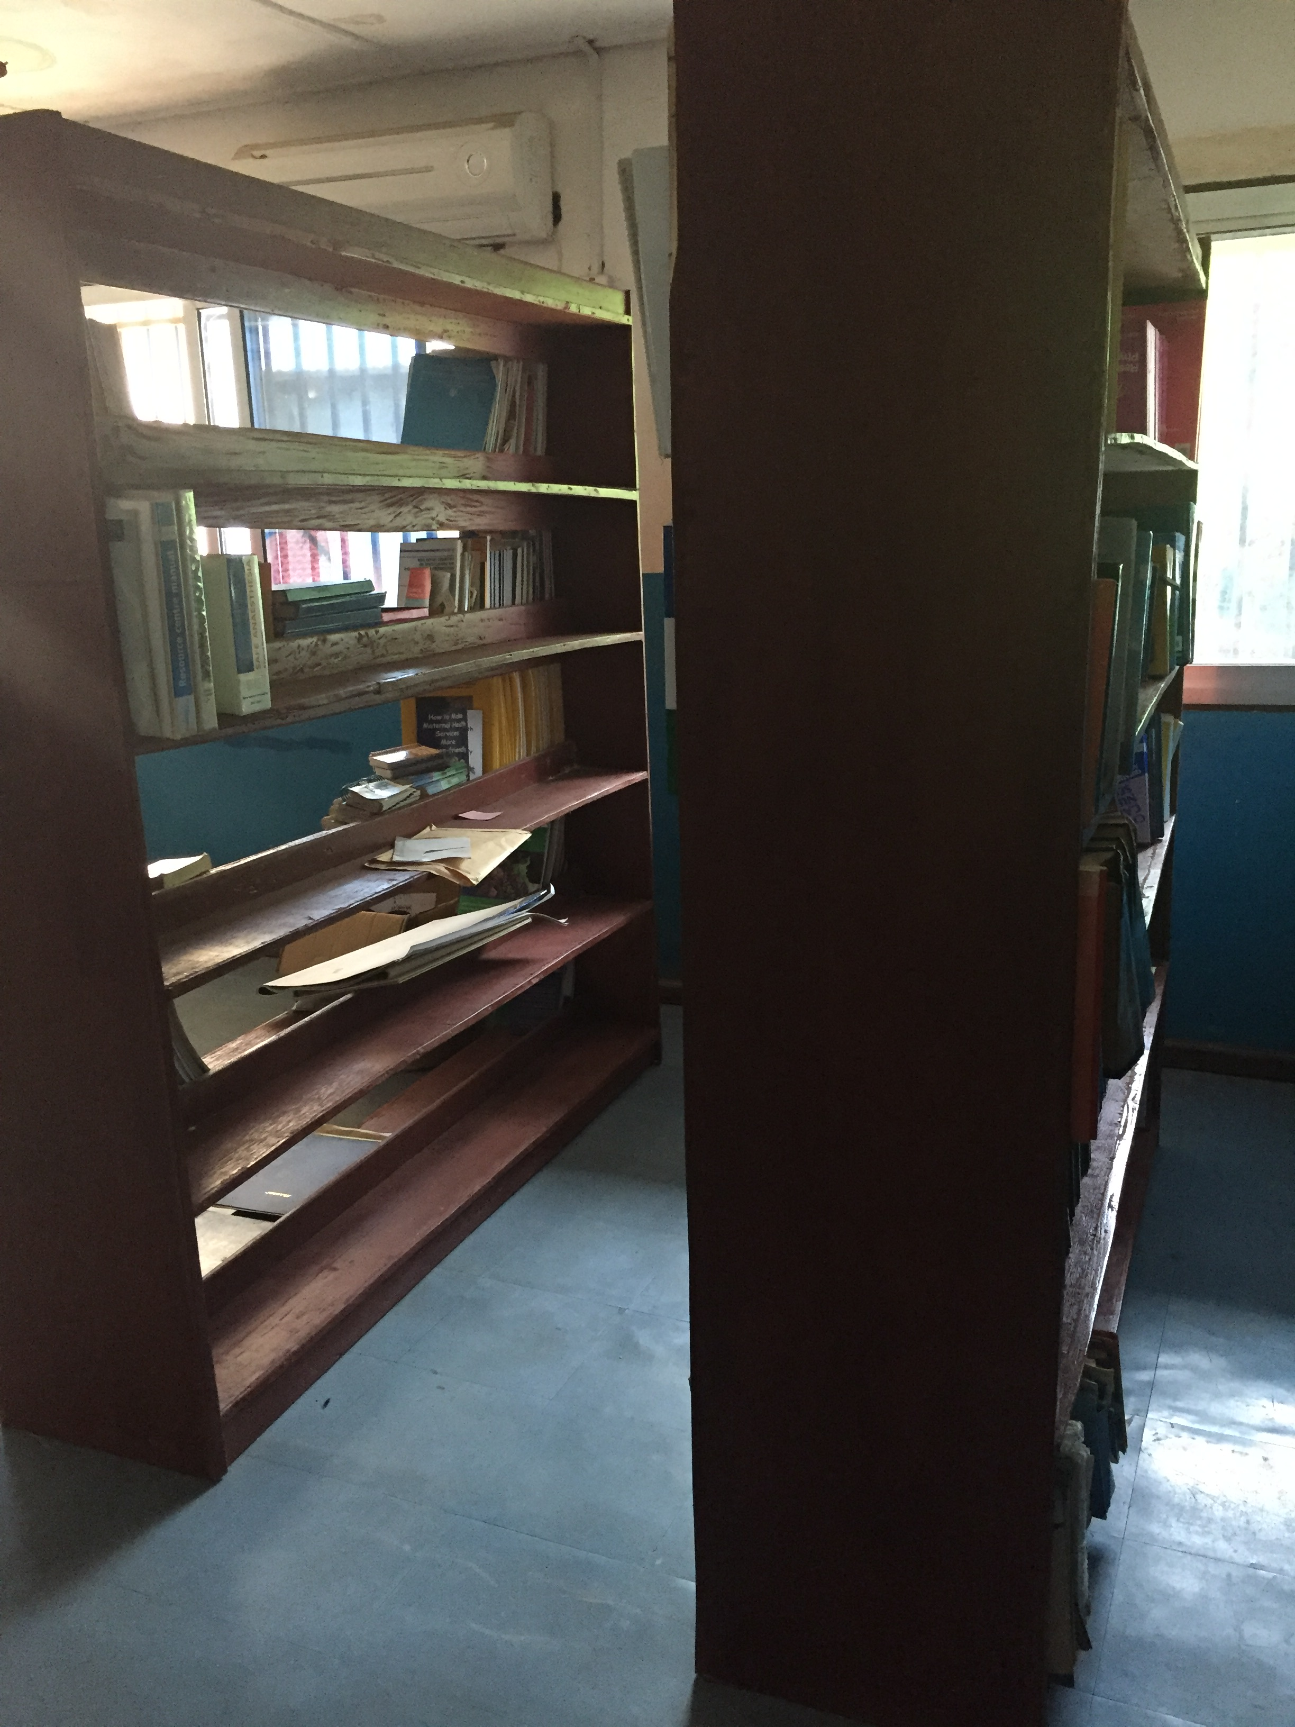

Slide 17
Key to the Problem: Education
In Sierra Leone the key is better nursing and midwifery education
In the US, the key is inspiring today’s students to be global thinkers
How do we do that?
Changing the mindset from asking students what they want to be when they grow up to asking them how they would like to contribute to the world, or what problems would they like to solve

Slide 18
How Can People Contribute to Healthcare without Becoming a Nurse or a Doctor
Roads and bridges
IT
Clean water
Construction
Shipping
Procurement
Disabilities
Legal
Laboratory (Ebola)
Educators

Slide 19
Inspire Through Personal Connections
Learning about Malaria? Contact someone at the CDC or the WHO
Watch TED talks about specific issues
Tap into your own students about their friends and family that might be doing interesting global things
Find the things that inspire you and pass that on
Have students choose and report on an NGO
Contact a specific individual or organization that is providing some global impact and ask them to connect with your class, through email or Skype or FaceTime (Kiva)

Slide 20
Career Pathways Are Not Always The Same
Advice to students
Community College
Technical School
University
Volunteer
Study abroad
Our own pathways

Slide 21
Questions

